Slide 1
Block Breaker
Ahmad Ahbab, Bibartan Jha, & Tanitoluwa Adebowale

Slide 2
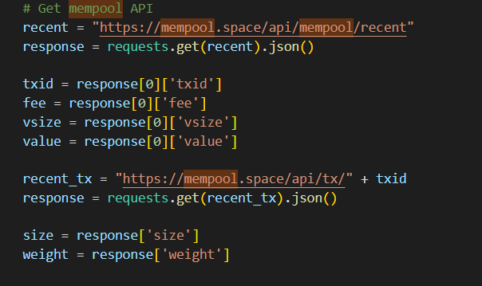
What is it?
Block Breaker is the game Brick Breaker with a twist!
Every time a new game is started, we run a query on the mempool API
This query tells us the most recent transaction on the Bitcoin Blockchain
We use values on this transaction to determine different attributes of the game

Slide 3
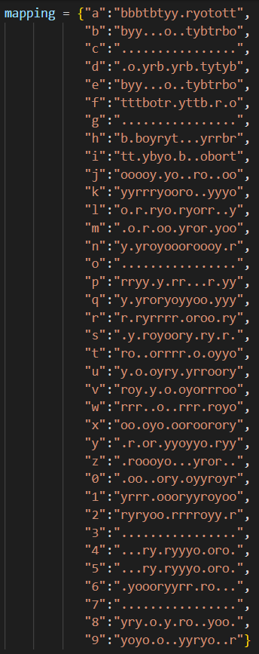
Attributes
Blocks layout
Based on the first 14 characters of the txid, where each character (a-z, and 0-9) is mapped to a specific row orientation
Paddle width
Based on weight
After fine tuning, we found that ((weight%10 + 4)*10) gave us the best range of paddle sizes to play with (for example, a paddle width of 1 is very much not playable)
Ball speed
Based off (fee % 9) + 1

Slide 4
DEMO

Slide 5
Potential Future Work
New game features -
Add a point system
Each block in the game will now be based off of a block from the blockchain
Hitting the block in the game will get you points equivalent to the fee of the block
Add a rewards system
Players gets certain amount of sats based on how many blocks hit
Adding set of levels based on each block in the chain

Slide 6
Thanks for Listening!

Slide 7
Sources
https://github.com/lcswillems/python-brick-breaker

